Slide 1
Understanding the Importance of Agriculture to Society
Ag Science 1

Slide 2
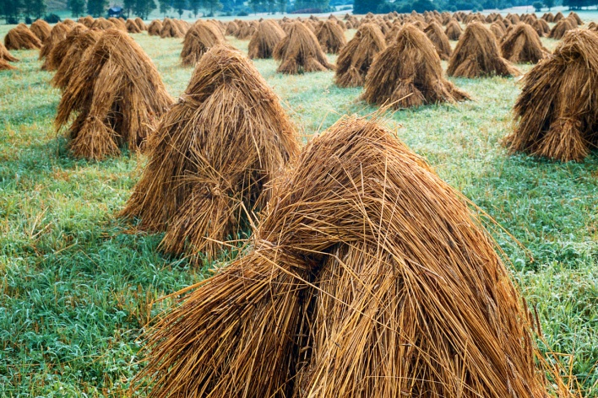
How is Agriculture Important to Society?

Slide 3
Topics to Consider……..
1. Define quality of life.
2. Discuss modern agriculture’s role in basic human nutrition.
3. List agricultural products used to provide food.
4. Identify agricultural products used to provide clothing.
5. Identify agricultural products used to provide human shelter.
So Agriculture’s importance to society affects our quality of life, our nutrition, our food, clothing, and where we live.

Slide 4
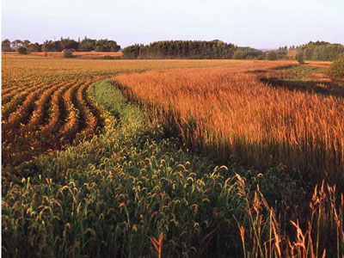
Quality of Life
What is meant by quality of life?
A. Quality of life includes adequate supplies of basic needs like food, clothing, and shelter.
B. Agriculture provides food, clothing, and shelter. It helps people to enjoy a higher quality of life.

Slide 5
Quality of Life
The U.S. is a strong nation that produces an abundance of food, fibers for clothing, and material for the construction of homes.
Americans spend only 11% of their total income on food. This compares to 70% in other countries.
This allows for more money to be spent on clothing, housing, and entertainment.
Agriculture helps meet our needs and the needs of millions of people in other countries.
Agriculture provides jobs for more people than any other industry in the United States.
Approximately 16 out of every 100 people in the U.S. work in agriculture.

Slide 6
Quality of Life
International trade is buying and selling commodities by two or more nations.
Goods sold to or in another country are exports. Examples of agriculture exports are
corn, rice, soybeans, wheat, poultry, and cotton.
Imports are products bought from another nation. Imports include bananas, cocoa,
vanilla, shrimp, and coffee.

Slide 7
Lets Review…..
What percent of income do Americans spend on food?
What is international trade?
Explain the difference between imports and exports? Provide an example of each
What industry provides the most jobs to people in the United States?
What is included in the meaning of Quality of Life?

Slide 8
Agriculture’s Role in Human Nutrition
Today, one American farmer feeds over 130 people.
Consumers have a year-round wide selection of agricultural products at the local grocery store. Even with all of the nutritious food available, most consumers do not make the right choices. Americans consume foods that are high in fat, salt, and sugar.
The United States Department of Agriculture developed the Food Guide Pyramid-a tool to help people make healthy eating choices.

Slide 9
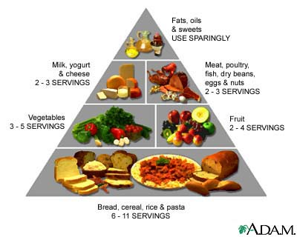

Slide 10
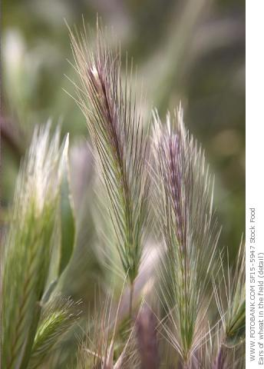
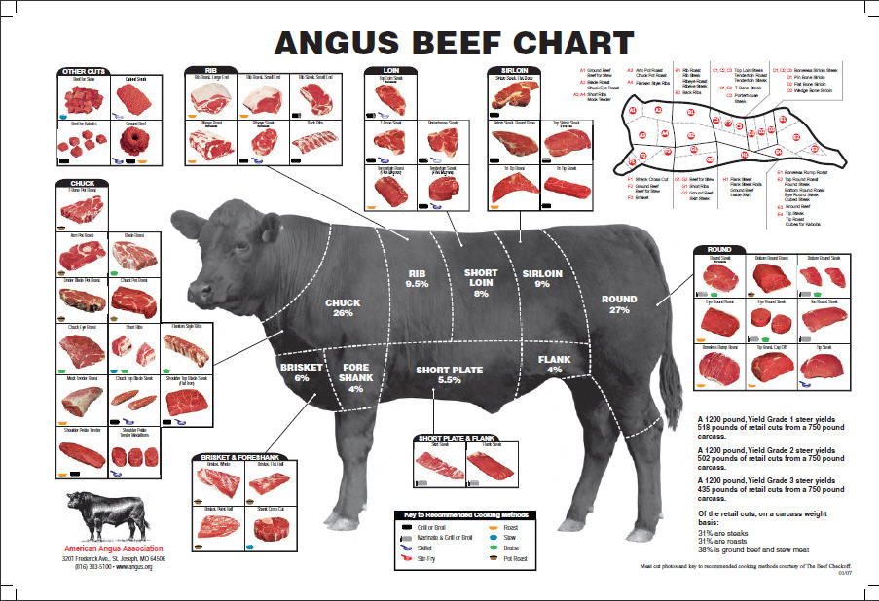
Agriculture Products used to Provide Food
Grain
Fruit
Vegetables
Milk
Meat
Nuts

Slide 11
Grains
1. Grain crops are grown throughout the United States, with the greatest region of production in the Midwest.
2. Grain crops are used for bread, pasta, rice, cereal, and many other food products.
3. Wheat and rye are two important examples of grains.

Slide 12
Fruit
1. Citrus is grown in California and Florida and imported from Mexico and South America.
a. Citrus grown in the United States includes oranges, grapefruit, tangerines, tangelos, lemons, and limes.
b. Most of the fruit crop is sold as fresh fruit, and the rest is processed for juices.
2. Apples are grown in Washington, New York, Michigan, and California.

Slide 13
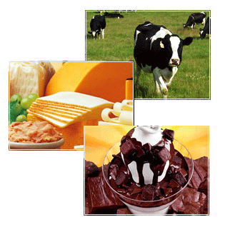
Vegetables
Milk
1. Cool weather crops, such as lettuce and broccoli, are grown in northern states in the summer and in the southern states during the winter.
2. Most warm weather vegetables are grown in California and Florida.
3. Many vegetables consumed in the U.S. are imported from South America and Mexico
Leading milk production states are California and Michigan

Slide 14
Meat
Meat includes poultry, fish, beef, pork, and lamb.
a. Poultry includes any domesticated birds grown for food.
(1) The most poplar poultry is chicken followed by turkey.
(2) Chickens also produce most of the eggs consumed in this country.
b. Beef is meat from cattle. It is prepared into popular dishes like steak and hamburger.
c. Pork is the meat of swine.
(1) Swine is the plural term used to define hogs and pigs.
(2) Pork chops and bacon are two popular forms of pork.

Slide 15
Meat
d. Aquaculture is the production of aquatic plants and animals for food.
(1) Fish are being farmed in oceans, streams, lakes, ponds, and raceways.
(2) Fish are harvested, processed, and prepared for the fresh or frozen market.
e. Lamb refers to meat from a sheep that is less than a year old.
(1) Mutton refers to meat from a sheep that is over a year old.
(2) Compared to beef, chicken, and pork, Americans eat relatively little lamb and mutton.

Slide 16
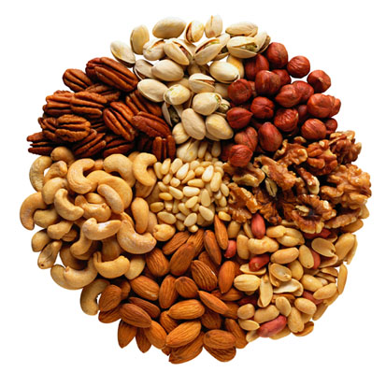
Nuts
1. Each year in the United States 430,000 tons of nuts are produced.
2. There are four major types of nuts with commercial importance—almonds, pecans, walnuts, and filberts.
3. Nuts are removed from a tree by a machine that gently shakes the tree. The nuts are then picked up form the ground by a nut sweeper.

Slide 17
Lets Review….
What are the six broad agriculture products?
What are some agricultural products grown in California?
Lets think a little deeper….
How does California agricultural play a vital role in the food products provided to society?

Slide 18
Agriculture Products used to make Clothing
Clothing is made form natural and synthetic fibers. A natural fiber is from a plant or animal.
Synthetic fibers are manufactured from petroleum and other substances.
A. Cotton is a shrub-like plant
1. Leading states in the production of cotton are California, Texas, Arizona.

Slide 19
Clothing….
The flax plant produces fibers used in making a high quality cloth called linen.
The seeds of the flax plant are pressed for linseed oil. This oil is used in making paints and varnishes.
Wool and fur are two animal fibers used in making clothing.

Slide 20
Agriculture products used to create shelters
Forestry is the science of planting, caring for, and harvesting trees. In the United States there are 736.7 million acres of forest land. Forestry products are made into many kinds of lumber, plywood, particle board, veneer, and paper. These products are used in many ways—shelter being the most important.
A. Forestry products are grouped by the types of trees harvested. The two major types of trees are hardwood and softwood.
1. Hardwood trees are deciduous trees. A deciduous tree sheds its leaves in the winter.
2. Softwood trees are conifers. Conifers are evergreen trees that usually have cones and needles instead of leaves.

Slide 21
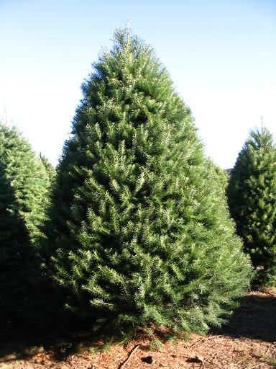
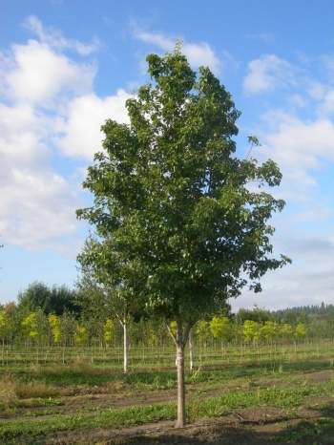
Trees….
Deciduous
Conifers

Slide 22
One More Review…
Clothing can be made from what two types of fiber?
What is an example of a natural fiber?
Define Forestry
What are the two types of trees and their differences?

